Slide 1
Functional Testing Types

Slide 2
Types of Testing
Sanity Testing
Smoke Testing
Regression Testing
Re-Testing
UAT Testing

Slide 3
Regression testing
Regression testing is a software testing practice focused on retesting existing functionalities of a software application to ensure that recent code changes, updates, or enhancements do not introduce new defects or regressions into the system.
It involves systematically rerunning previously conducted tests to validate that the software behaves as expected after modifications have been made.
The primary goal of regression testing is to maintain the stability, reliability, and quality of the software throughout its lifecycle, despite ongoing changes and updates.

Slide 4
When we do regression testing
After Code Changes: Regression testing is typically performed after any modifications, enhancements, or bug fixes have been made to the software codebase.
Before Releases: It's commonly executed before a new version or release of the software is deployed to production to ensure that new changes haven't introduced unintended side effects that could impact users.
Periodically: Even in the absence of specific changes, periodic regression testing may be performed as part of routine maintenance to catch any unforeseen issues that may have arisen over time.
Automated Builds/Integration: In continuous integration (CI) and continuous deployment (CD) environments, regression testing is often automated and triggered automatically after each code commit or integration to ensure that changes don't break existing functionality.
When Configuration Changes: Regression testing is necessary when there are changes in the configuration of the software environment, such as updates to the operating system, database, or third-party libraries.

Slide 5
How to run Regression testing
Identify Regression Test Cases: Review existing test cases to determine which ones are relevant for regression testing. Focus on test cases covering critical features, frequently used functionalities, and areas likely to be impacted by recent changes.
Prioritize Test Cases: Prioritize the identified test cases based on factors such as the criticality of the functionality, frequency of use, and the extent of changes made. This helps allocate resources effectively and ensures that the most critical areas are thoroughly tested.
Select Regression Testing Techniques: Choose appropriate regression testing techniques based on the nature of changes made. Techniques include retest all, selective retest, prioritized regression testing, and automated regression testing.
Prepare Test Environment: Set up the test environment to mirror the production environment as closely as possible. Ensure that all necessary hardware, software, configurations, and test data are in place.
Execute Regression Test Cases: Execute the selected regression test cases according to the prioritized order. Ensure that each test case is executed rigorously and thoroughly. Record test results, including any defects found.
Analyze Test Results: Analyze the test results to identify any discrepancies or deviations from expected behavior. Document any new defects or regressions discovered during regression testing.
Report Defects: Report any defects or regressions identified during regression testing in a defect tracking system. Provide detailed information about each defect, including steps to reproduce, severity, and priority.
Regression Test Automation: Consider automating regression test cases to improve efficiency and effectiveness. Automated tests can be run repeatedly, saving time and effort in future regression testing cycles.
Validate Fixes: If any defects are found during regression testing, validate fixes by retesting the affected areas to ensure that the issues have been resolved satisfactorily.

Slide 6
Regression Types
Unit Regression Testing:
Focuses on testing individual units or modules of the software.
Ensures that changes made to a specific unit do not break its existing functionality.
Typically automated and integrated into the development process.
Module Regression Testing:
Selectively retests only the areas of the software that are impacted by recent changes.
Test cases are chosen based on the modified code, affected functionalities, or related dependencies.
Helps save time and resources compared to retesting the entire application.
Full Regression Testing:
Involves retesting the entire application, regardless of the nature or scope of changes made.
Ensures comprehensive validation of all functionalities to detect any unintended side effects.
Time-consuming and resource-intensive but provides maximum assurance of software quality.

Slide 7
Re-testing
Retesting refers to the process of running tests on software or systems that have previously undergone testing, typically to ensure that defects or issues have been resolved or to verify that changes made to the system do not adversely affect its functionality.
Benefits of retesting include:
1. Bug Verification: Confirming that reported defects have been fixed and verifying that the fixes are effective.
2. Regression Testing: Ensuring that changes made to the software haven't introduced new defects or caused unintended side effects.
3. Quality Assurance: Enhancing the overall quality of the software by identifying and addressing any remaining issues.
4. Risk Reduction: Minimizing the risk of deploying software with unresolved defects or introducing new defects due to changes.
5. Customer Satisfaction: Improving customer satisfaction by delivering software that meets or exceeds expectations in terms of functionality and reliability.
6. Cost Savings: Identifying and fixing defects earlier in the development process can reduce the cost of fixing them later, when they are typically more expensive to address.

Slide 8
Smoke testing
Smoke testing, also known as build verification testing or sanity testing, is a preliminary testing phase applied to a software build or release. Its primary objective is to determine whether the build is stable enough for further, more comprehensive testing.
Smoke testing typically involves executing a set of basic tests that cover the most critical functionalities of the software. These tests are designed to quickly assess whether the key features of the application are functioning correctly. Smoke tests are usually automated and can be run swiftly after a build is completed.
When to conduct smoke testing:
1. After each build: Smoke testing is performed after every build to ensure that fundamental functionalities are intact before proceeding with more extensive testing. This helps in catching major issues early in the development process.
2. Before comprehensive testing: Before initiating comprehensive testing such as regression testing or system testing, smoke testing is conducted to ensure that the build is stable enough to withstand more rigorous testing.
3. After integration: If multiple modules or components are integrated to form a build, smoke testing is done to verify that the integration has not introduced any critical defects.
4. Before release: Smoke testing is often performed before releasing a software build to production or to clients, ensuring that the release is stable and reliable.
In summary, smoke testing serves as a quick and initial check to ensure that the basic functionalities of the software are working as expected, providing confidence to proceed with further testing and development activities.

Slide 9
Sanity testing
Sanity testing, also known as sanity checking or sanity verification, is a type of software testing that aims to quickly evaluate whether a specific set of functionalities or changes in a software application are working as expected after a minor change or a bug fix. It is not intended to be exhaustive; rather, it focuses on verifying that the critical functionalities of the system are still intact and haven't been adversely affected by the recent changes.
Sanity testing is typically performed when:
Minor Changes are Made: After making minor modifications to the software, such as bug fixes or small enhancements, sanity testing helps ensure that the core functionalities remain unaffected.
Build Verification: Before conducting more comprehensive testing, such as regression testing or full functional testing, sanity testing can quickly check whether the software build is stable enough to proceed with further testing.
Integration Testing: After integrating different components or modules of the software, sanity testing can be used to verify that the integration hasn't caused any major issues.
Critical Fixes: When critical defects are fixed, sanity testing ensures that the most critical functionalities related to the fixed defects are working as expected.
Pre-release: Prior to releasing a software build to stakeholders or customers, sanity testing can provide confidence that the critical functionalities are functioning properly, helping to avoid embarrassing or critical issues in production.
Overall, sanity testing helps in ensuring that the software is stable and ready for more comprehensive testing or release. It provides a quick check to catch major issues early in the development process, saving time and resources.

Slide 10
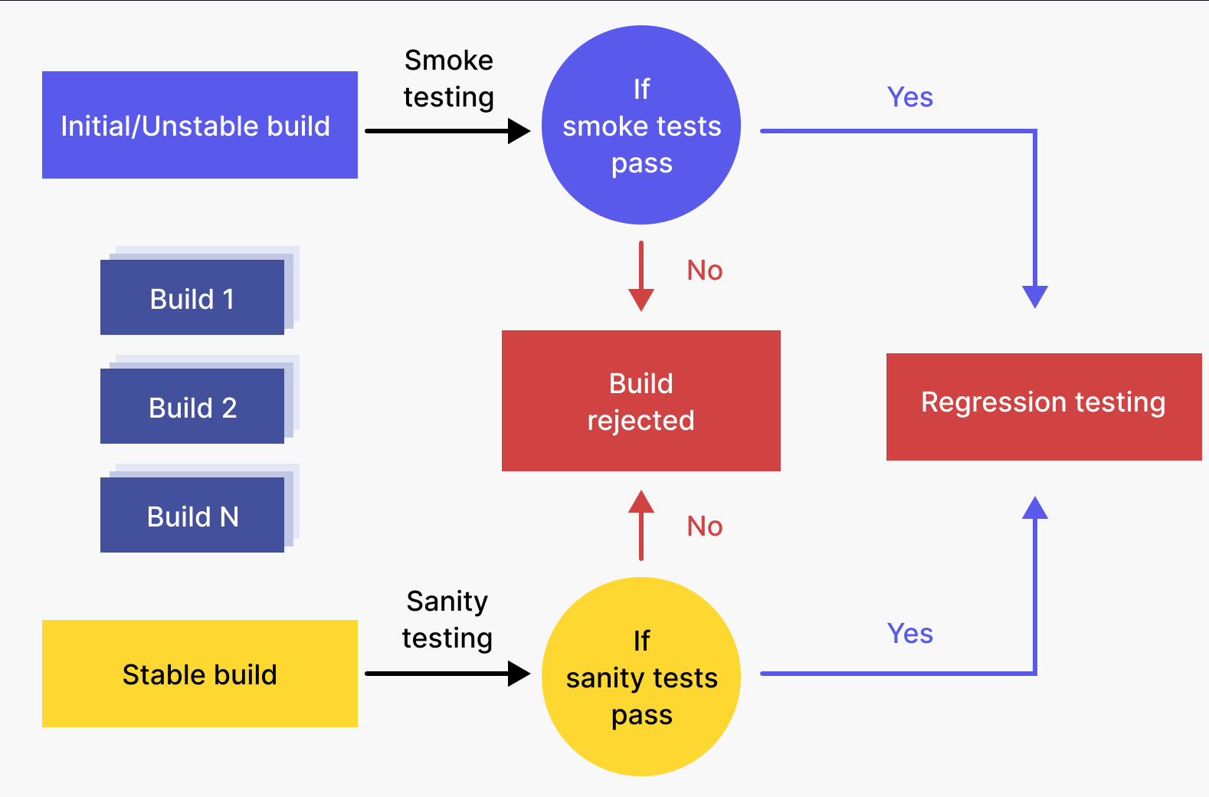
Smoke vs Sanity

Slide 11
UAT
UAT stands for User Acceptance Testing. It is a critical phase in the software development lifecycle where the software is tested by end-users or client representatives to determine whether it meets their requirements and expectations.
Key points about UAT testing:
1. Performed by End-Users or Clients: UAT is conducted by the intended users of the software or client representatives who will ultimately use the system in their day-to-day operations.
2. Focus on Business Requirements: The primary objective of UAT is to validate whether the software meets the specified business requirements and objectives. It aims to ensure that the software fulfills its intended purpose and adds value to the users' workflow.
3. Real-World Testing Environment: UAT is conducted in a real-world environment that closely mirrors the production environment. This allows users to interact with the software in conditions similar to those they will encounter during actual usage.

Slide 12
UAT
4. Testing for Usability and Functionality: UAT evaluates not only the functionality of the software but also its usability, user interface, and overall user experience. Users provide feedback on the intuitiveness of the system and its ability to support their workflows effectively.
5. Test Cases Based on User Scenarios: Test cases for UAT are typically derived from real-world user scenarios and business processes. Users perform tasks representative of their daily activities to assess how well the software supports their needs.
6. Final Stage Before Deployment: UAT is one of the last stages in the software testing process, usually conducted after system testing and integration testing. Its completion signifies that the software is ready for deployment, pending any necessary fixes or adjustments based on user feedback.
In brief, UAT is essential for ensuring that the software meets user expectations and business requirements before it is deployed into production. It serves as a final validation step to confirm that the software is ready for widespread use and adoption.

Slide 13
